Slide 1


KICKAAS
KICK AS A SERVICE
Johannes Bekele, Saniya Bhambhvani, Javier Esteban de Celis, Vamsi Garghi, Yuanfei He, and Shreya Rana

Slide 2

TABLE OF CONTENTS
Our Team
Our Project
Design and Architecture
Features
Demo
Testing
Notes:
Javi

Slide 3

OUR TEAM
OUR TEAM
OUR TEAM
OUR TEAM
OUR TEAM
Notes:
Javi

Slide 4




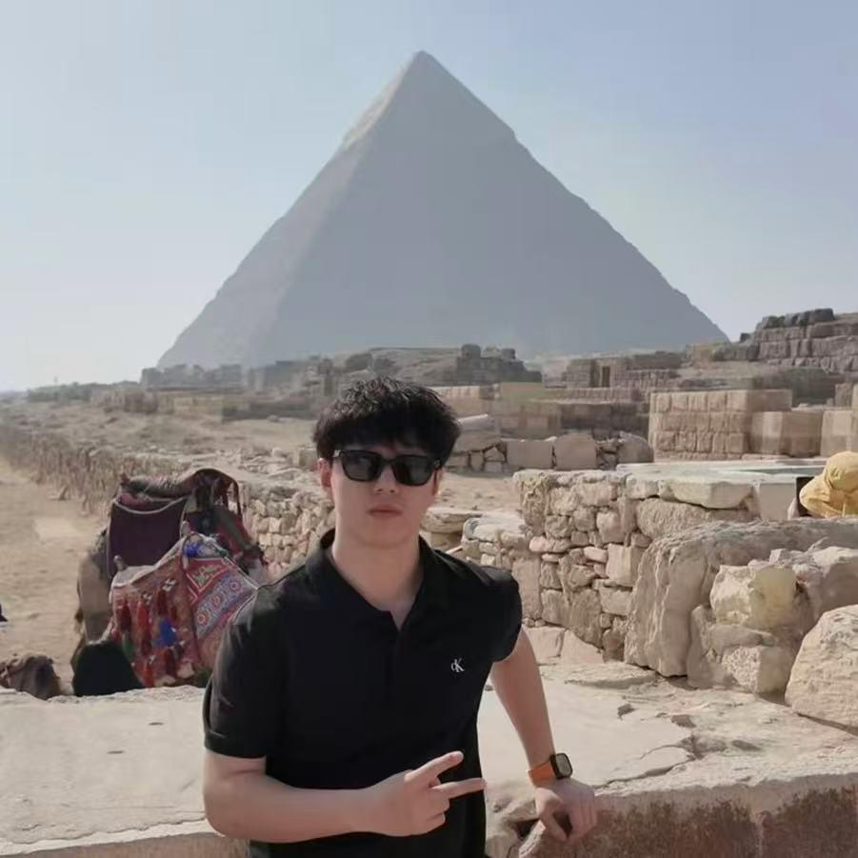
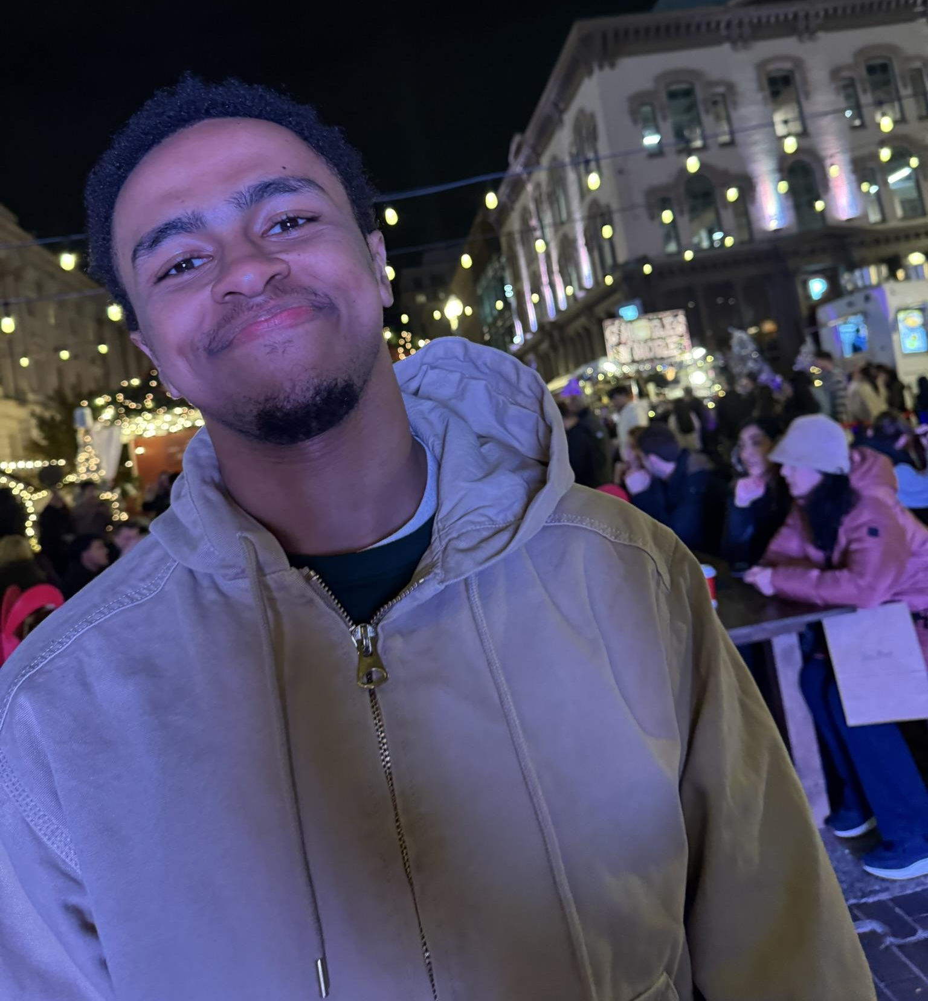
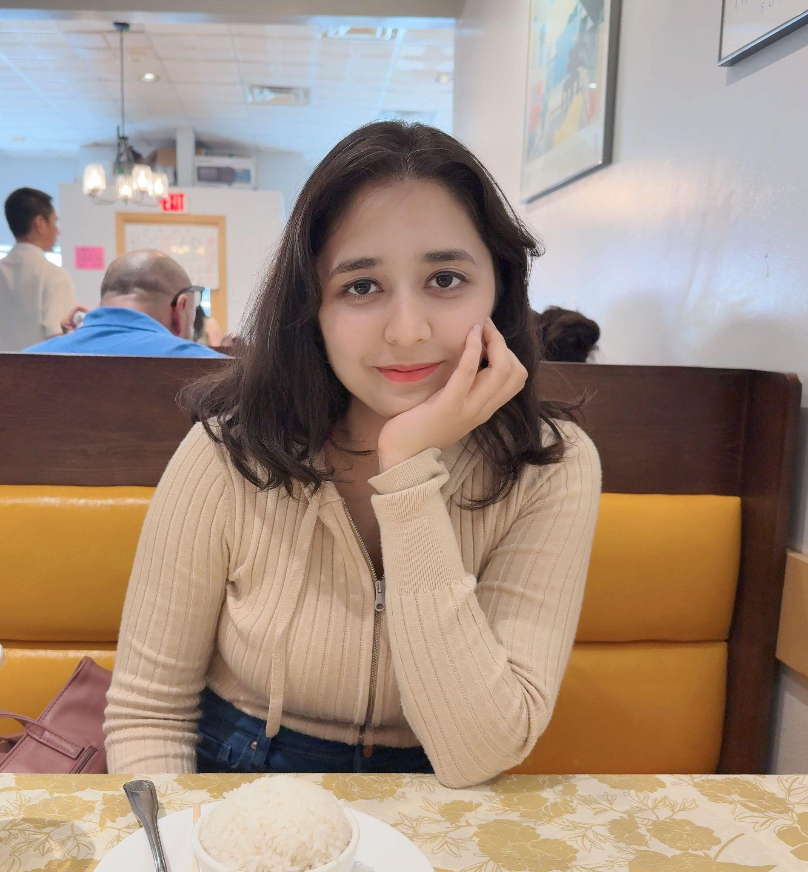
OUR TEAM
Javier Esteban de Celis
Saniya Bhambhvani
Configuration Leader
Team Leader
Vamsi Garghi
Yuanfei He
Requirement Leader
QA Leader
Johannes Bekele
Shreya Rana
Design and Implementation Leader
Security Leader
Notes:
Javi

Slide 5

OUR PROJECT
OUR PROJECT
OUR PROJECT
OUR PROJECT
OUR PROJECT
Notes:
Saniya and Shreya

Slide 6




PROJECT SCOPE
Motivation and Purpose
Users find other applications overwhelming and complex to use. Our team wants to develop a lightweight, privacy-conscious application to allow users to easily create and manage events. Our Event Manager will work to enhance user functionality, focus on design quality.
Notes:
Shreya

Slide 7

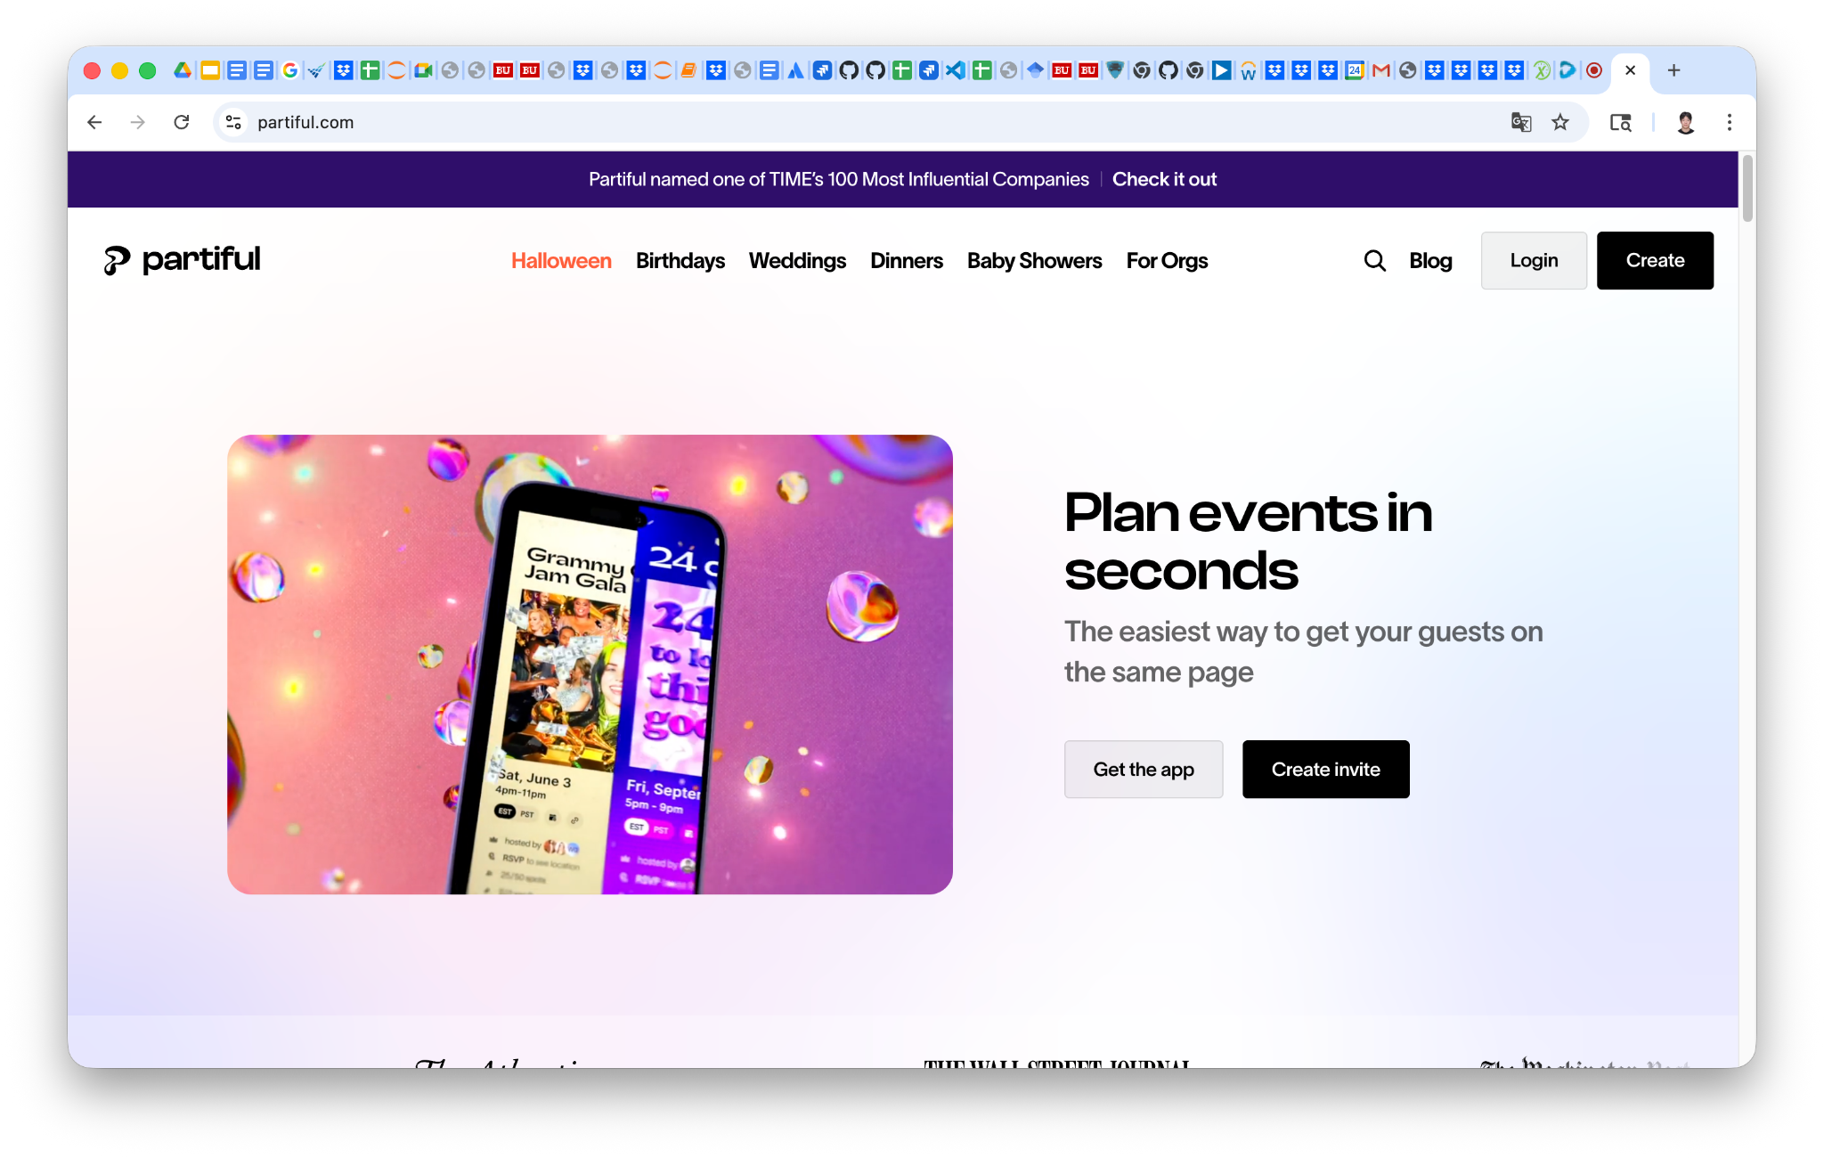
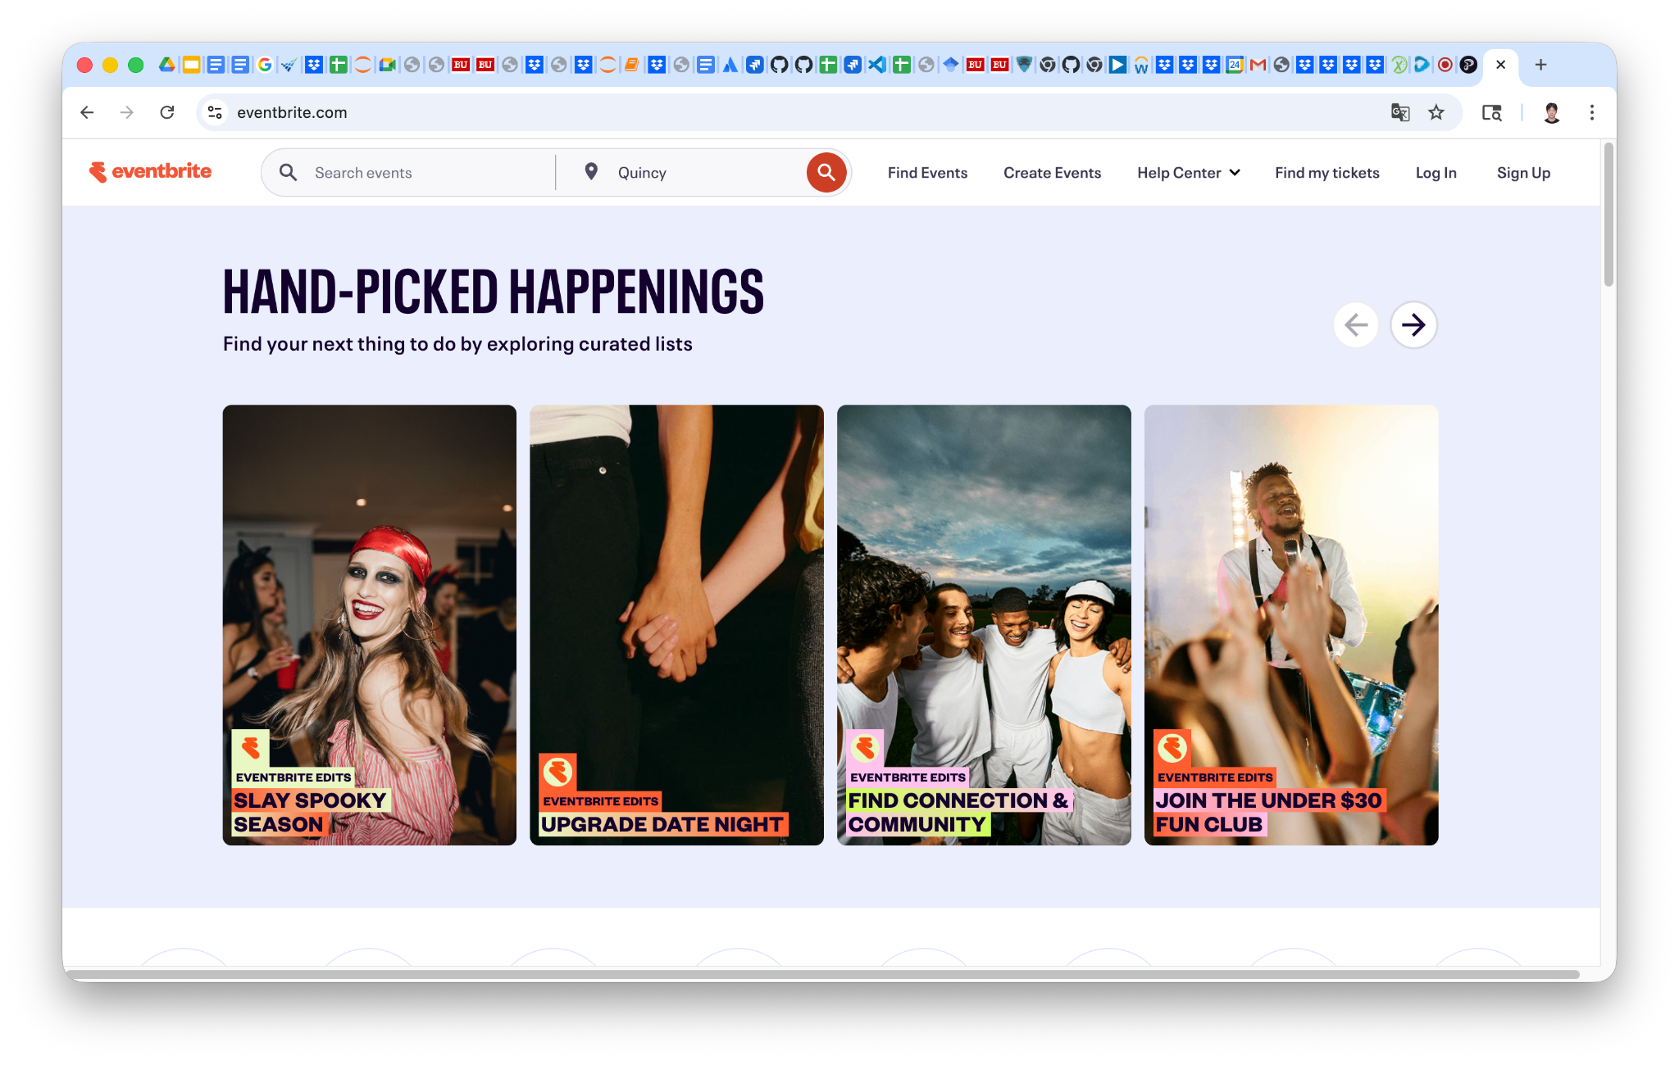
COMPETITORS
Partiful
Eventbrite
Notes:
Shreya

Slide 8
EVENT MANAGER
Event Manager is a lightweight, privacy-conscious application that allows users to create and manage various events. It includes many user-friendly features such as:
Event Creation and Management
Ticketing and Registration
Digital Ticket Delivery
Interactive Maps for Discovery
Notes:
Saniya

Slide 9
TECH STACK
Next.js and Tailwind CSS
OAuth2
Frontend Development
User LogIn
REST APIs (Python + FastAPI)
Git/GitHub
Backend Development
Version Control
PostgreSQL and SQLite
Docker
Database Development and Testing
Configuration Deployment
CI
Testing
Github Actions
ESLint and Prettier - Format - Test - Coverage - Build
uv + tox + ruff
Playwright and Jest
Notes:
Saniya

Slide 10

DESIGN AND ARCHITECTURE
DESIGN AND ARCHITECTURE
DESIGN AND ARCHITECTURE
DESIGN AND ARCHITECTURE
DESIGN AND ARCHITECTURE
DESIGN AND ARCHITECTURE
DESIGN AND ARCHITECTURE
DESIGN AND ARCHITECTURE
Notes:
Javi, Johannes, Sai, and Shreya

Slide 11



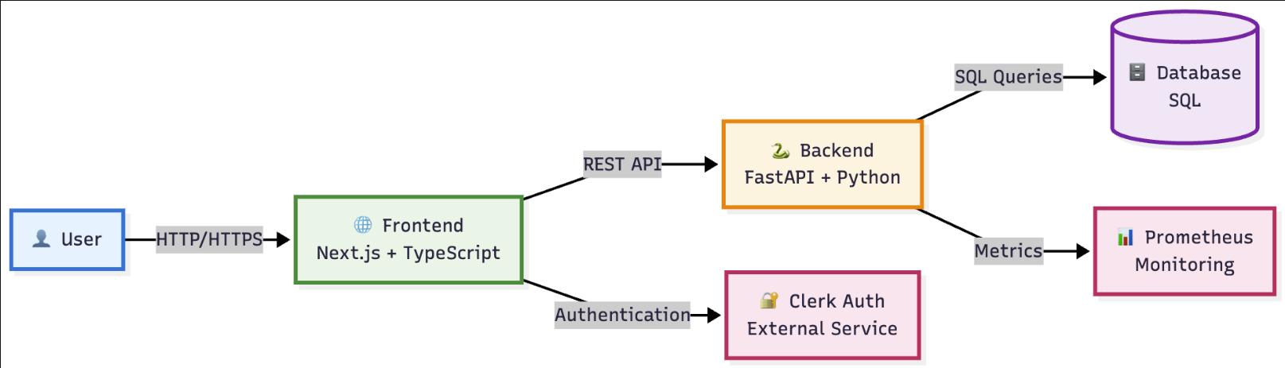
SOFTWARE ARCHITECTURE
Event Manager is a full-stack application that consists of separate software architectures for the frontend and backend. Both the frontend and backend consist of many different layers that aim to improve maintainability and scalability, and most importantly prevent any potential concerns/bugs.
Notes:
Javi

Slide 12
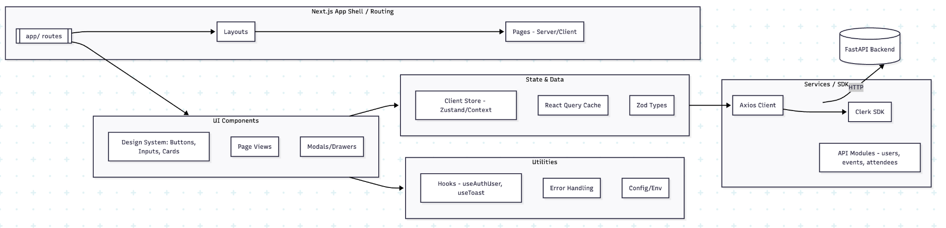
FRONTEND ARCHITECTURE
The frontend architecture has 5 layers including:
Next.js App Shell/Routing
UI Components
State and Data
API access encapsulated in /services which attach Clerk auth tokens. Zod schemas in src/types/.
Services/Software Development Kits (SDKs)
Utilities (Toast)
Notes:
Johannes

Slide 13
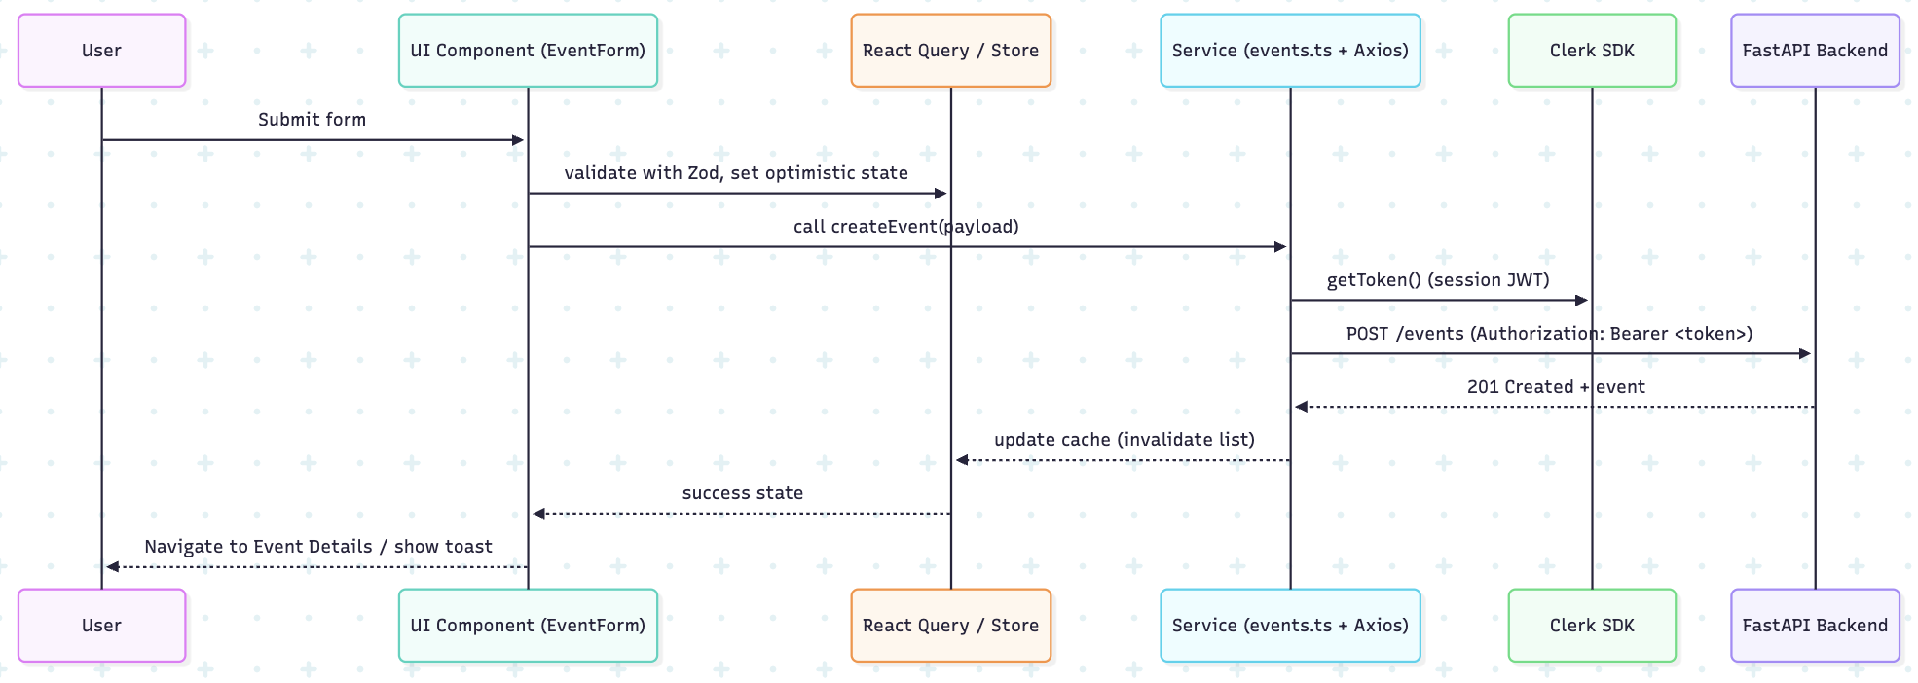
FRONTEND REQUEST FLOW
Notes:
Johannes

Slide 14
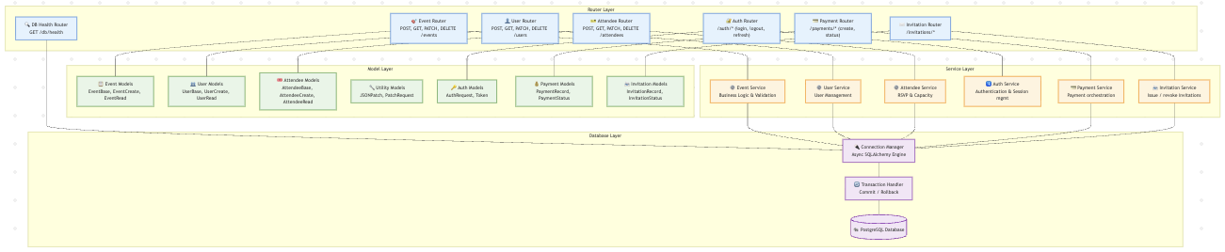
BACKEND ARCHITECTURE
The backend architecture has 4 layers including:
Router
Model
Service
Database
Notes:
Javi

Slide 15
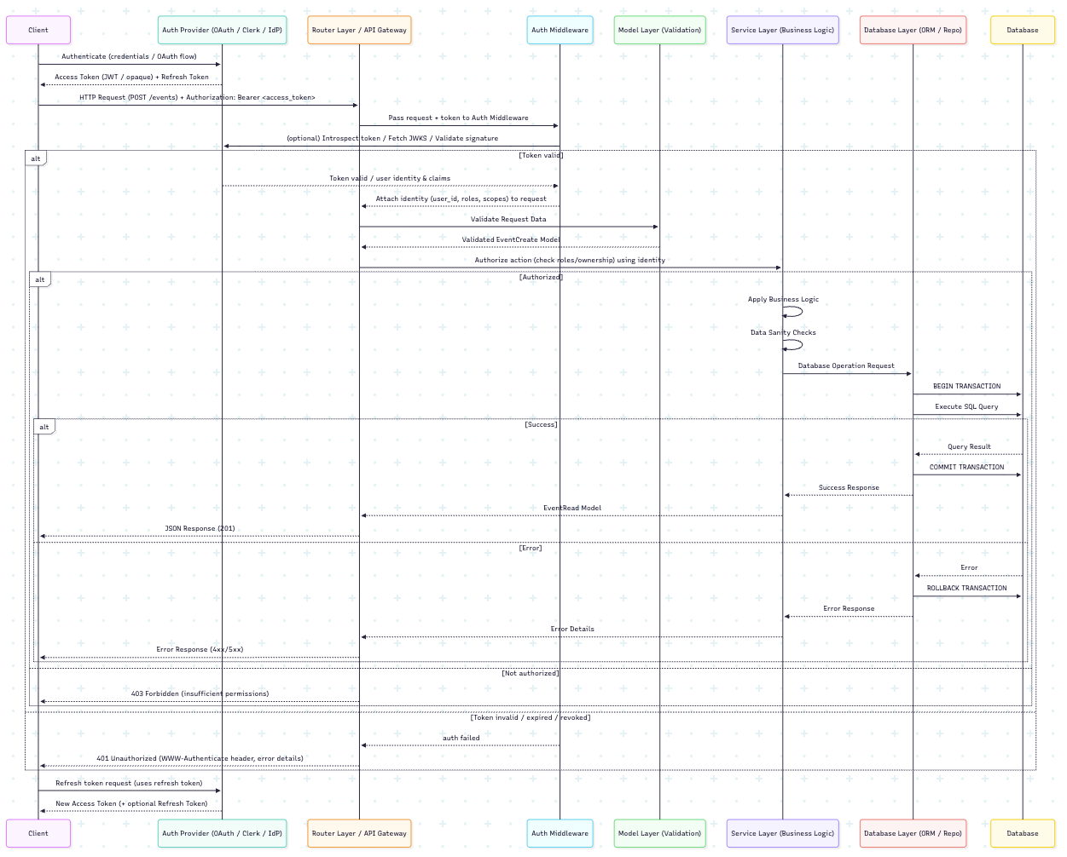
BACKEND REQUEST FLOW
Notes:
Javi

Slide 16
DATABASE ARCHITECTURE
Event Manager is using a PostgreSQL database because it prioritizes data integrity, scalability, and efficient query performance. Our database was designed to support all of the Event Manager’s essential functionalities such as user management, event creation, event invitations, and attendee registration which resulted in 6 tables:
Users
Events
EventAttendees
Categories
Invitations
Payments
Notes:
Sai

Slide 17
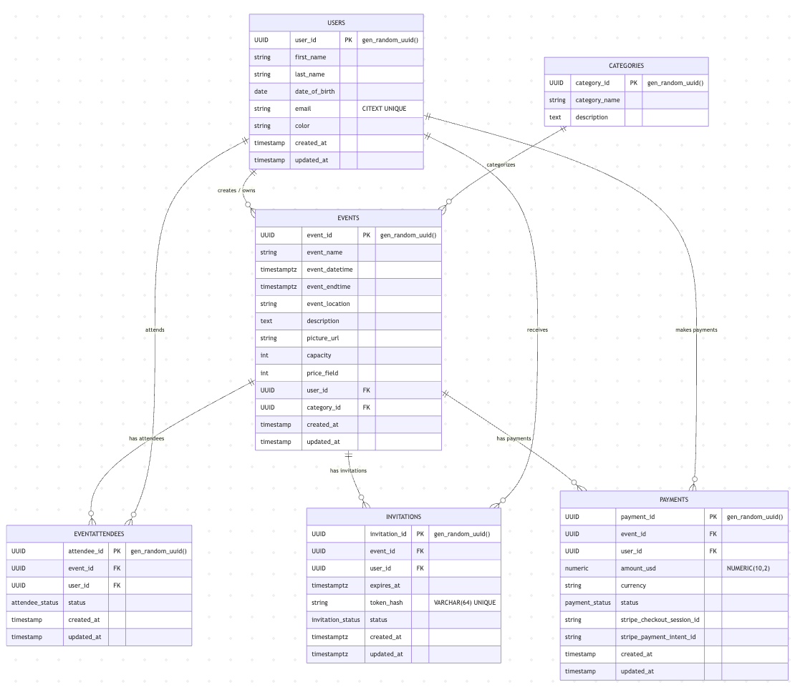
Notes:
Sai User can have many events, User can attend many events, events can have many invitation, user can do many payments, but payment can be only included to one person

Slide 18
UI ARCHITECTURE
Event Manager uses a Next.js w/ Tailwind CSS.
Pages (Top-level app routes):
Landing
Create Event
Events
dynamic routes [id]
Profile
Styles:
Headless UI
Fonts
Geist
Sanchez
React Font Awesome 6 (FA6)
Theme
Light/Dark Mode
Amber/Indigo
Global Layout:
Wrapped pages with Clerk auth provider, shared header, toaster, and invitation tray
Pages:
Landing
Create Event
Events
Profile
State/Logic Helpers:
Utilities and hooks live /helpers and /hooks (sorting, pagination, filtering).
Pages:
Landing
Create Event
Events
Profile
Notes:
Johannas

Slide 19
SECURITY ARCHITECTURE
Event Manager wants to ensure security across all layers of our application through authorization, data protection, and input validation using these tools:
Clerk
FastAPI/Pydantic
Semgrep
Hadolint
Pip-Audit
Gitleaks
Notes:
Shreya

Slide 20
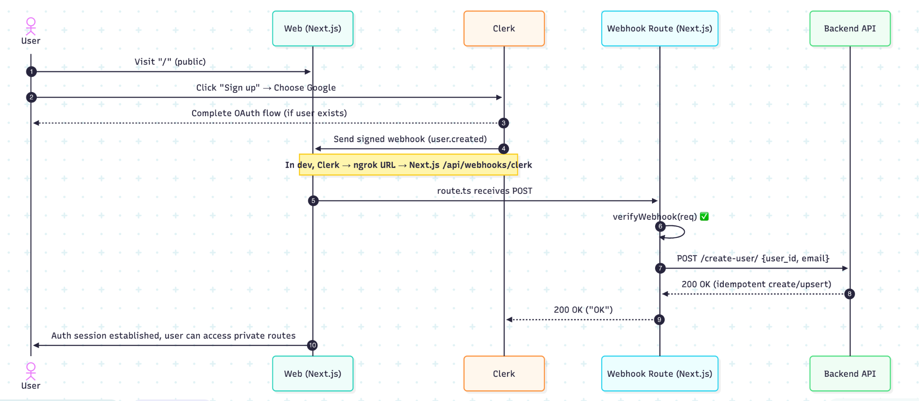
Notes:
Shreya

Slide 21
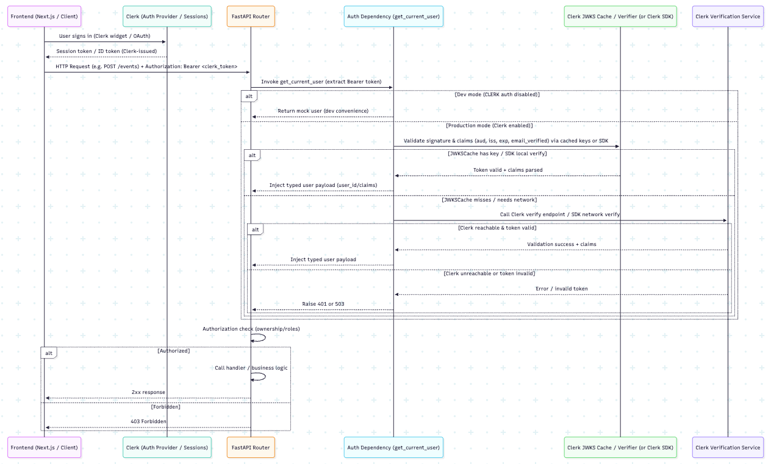
Notes:
Shreya

Slide 22
FEATURES
FEATURES
FEATURES
FEATURES
FEATURES
Notes:
Saniya and Sai

Slide 23


ALL FEATURES
Landing Page
Header
Create an Event
Events
Profile
Sign Up/Sign In
Create Event Form
Name
Category
Date/Time
Location
Price
Capacity
etc.
Events Page
Search Bar
Category Filter
Price Filter
Calendar Filter
Event Sort
Event Card
Discovery Map
Payment Support
Profile
User Profile Card
User’s Created, Registered, and Upcoming Events
Sign Up/Sign In
Google via Clerk
Invitations
Notes:
Saniya and Sai

Slide 24

LANDING PAGE
The Landing Page (Home Page) allows the user to understand how to use and navigate through the Event Manager application using the Header feature. The Header includes:
Home
Create Event
Events
Profile
Sign Up/Sign In
Notes:
Saniya

Slide 25
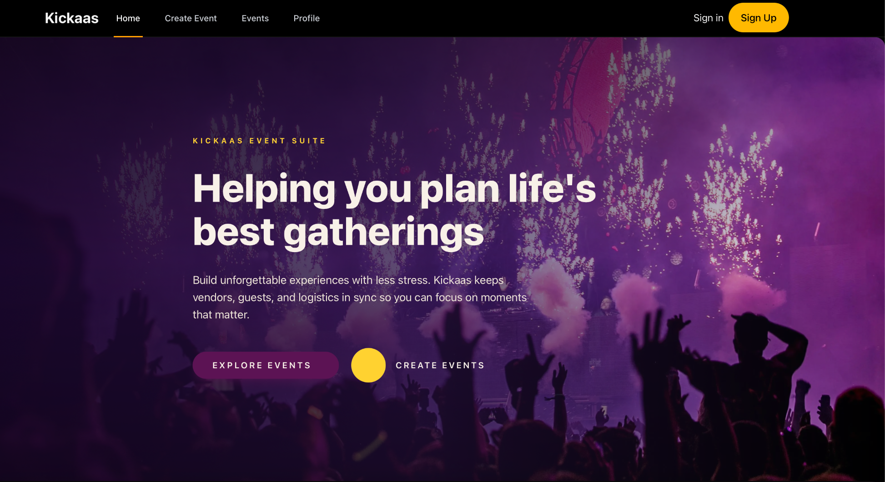
Notes:
Saniya

Slide 26
EVENT CREATION
To create an event within Event Manager there is a simple and easy to use Create an Event form that includes the following features:
Name Field
Category Field
Image Field (Optional)
Start Date and Time/End Date and Time Fields
Location Field
Capacity Field
Price Field (Optional)
Description Field (Optional)
Create Event Button
Notes:
Saniya

Slide 27
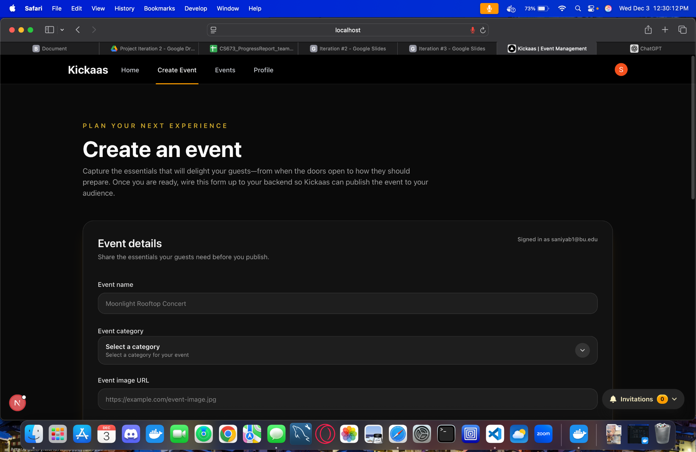
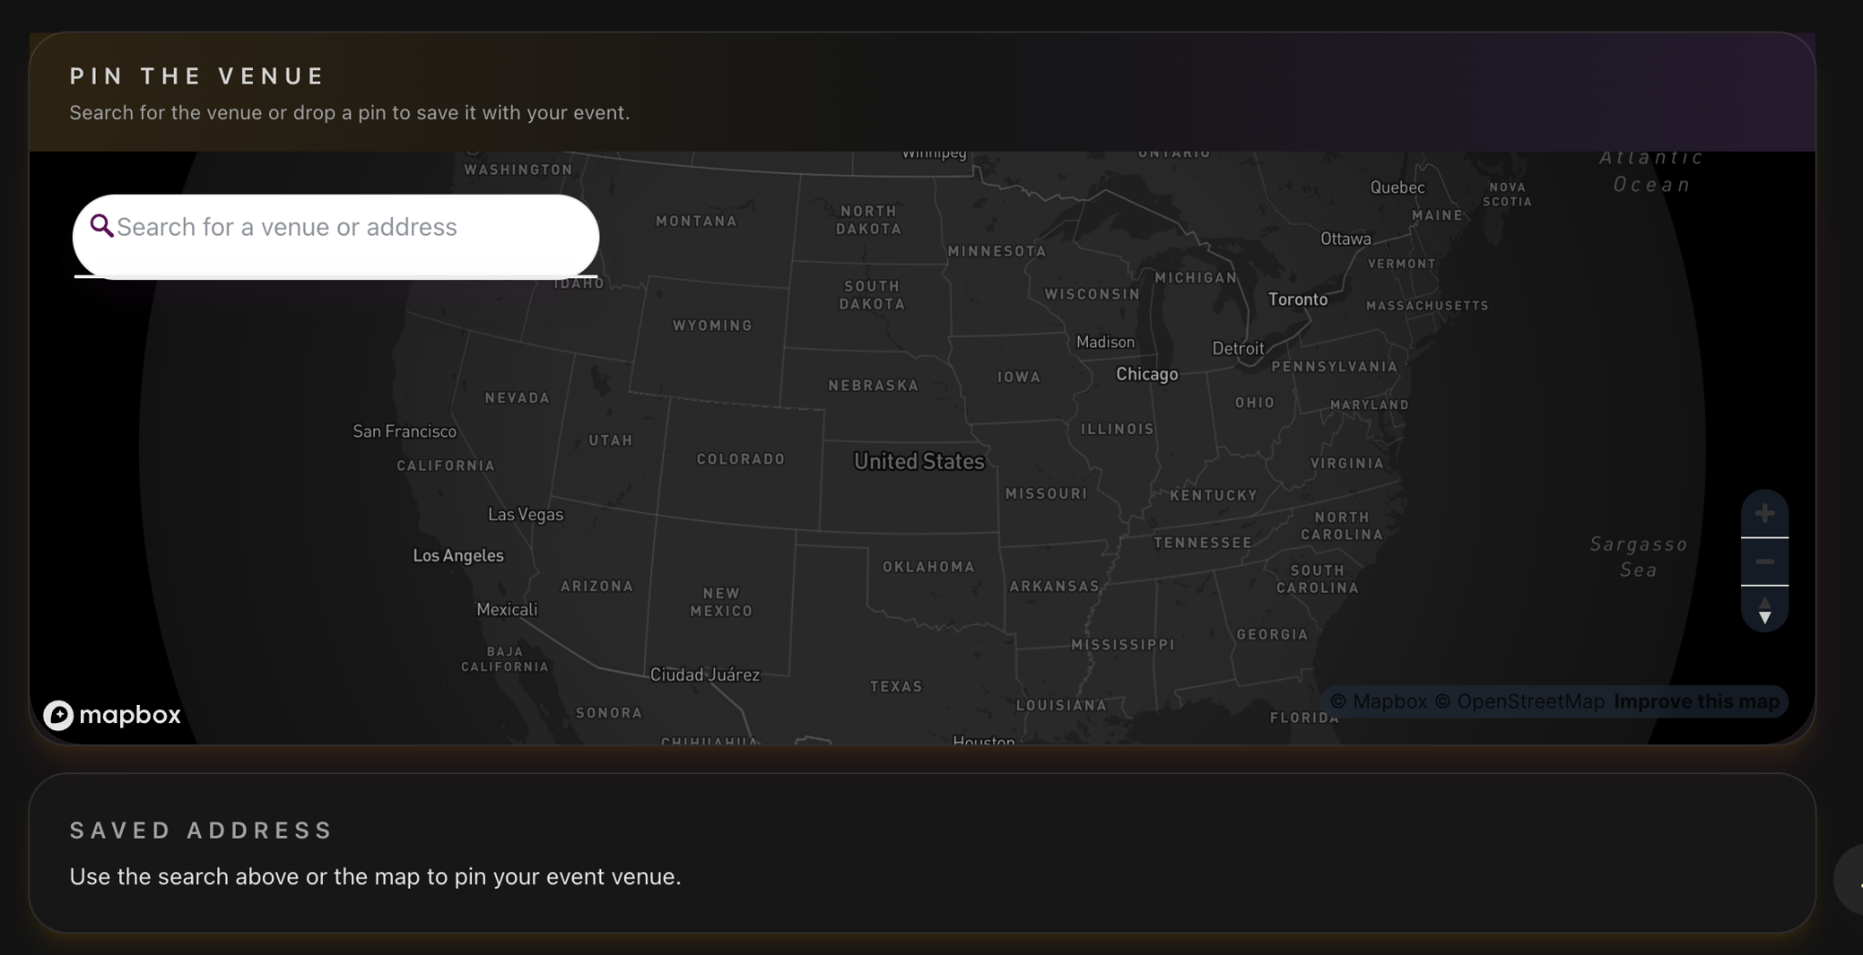
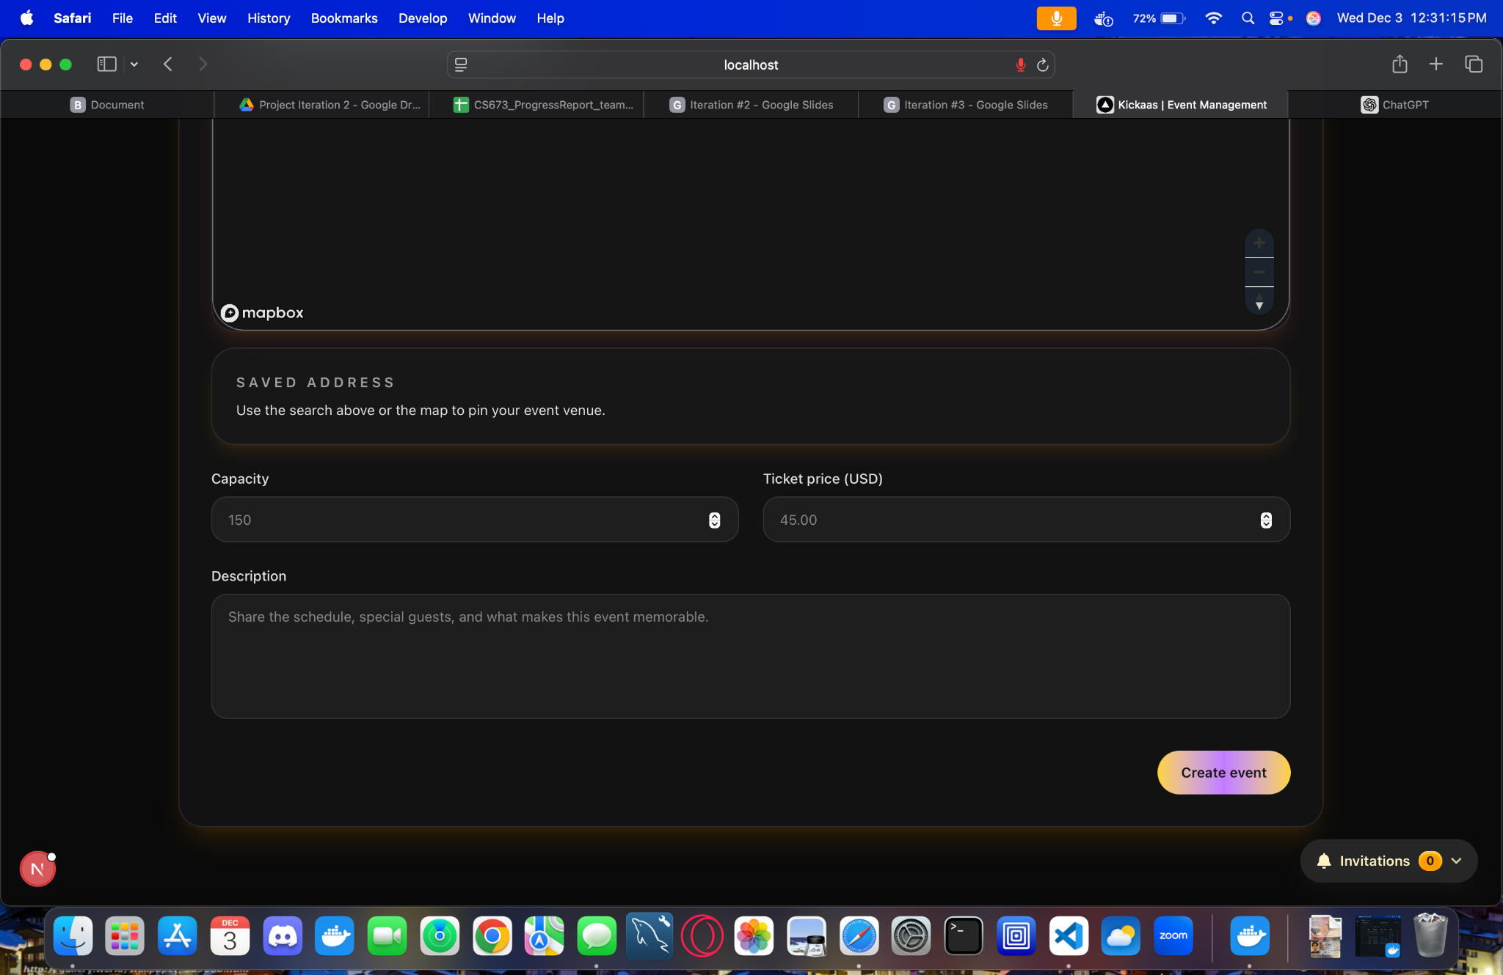
Notes:
Saniya

Slide 28
EVENT DISCOVERY
Once the user submits the Create Event form, the events are then displayed within the Events page. The user can search and filter through all of the events using these features:
Events Page
Search Bar
Category Filter
Price Filter
Calendar Filter
Event Sort
Date
Price
Capcity
A to Z
Z to A
Notes:
Saniya
Talk about how filter does an actual filter (price will gave price in this those range) where event sort does it in ascending order (Date, Price, Capacity, A to Z, and Z to A)

Slide 29
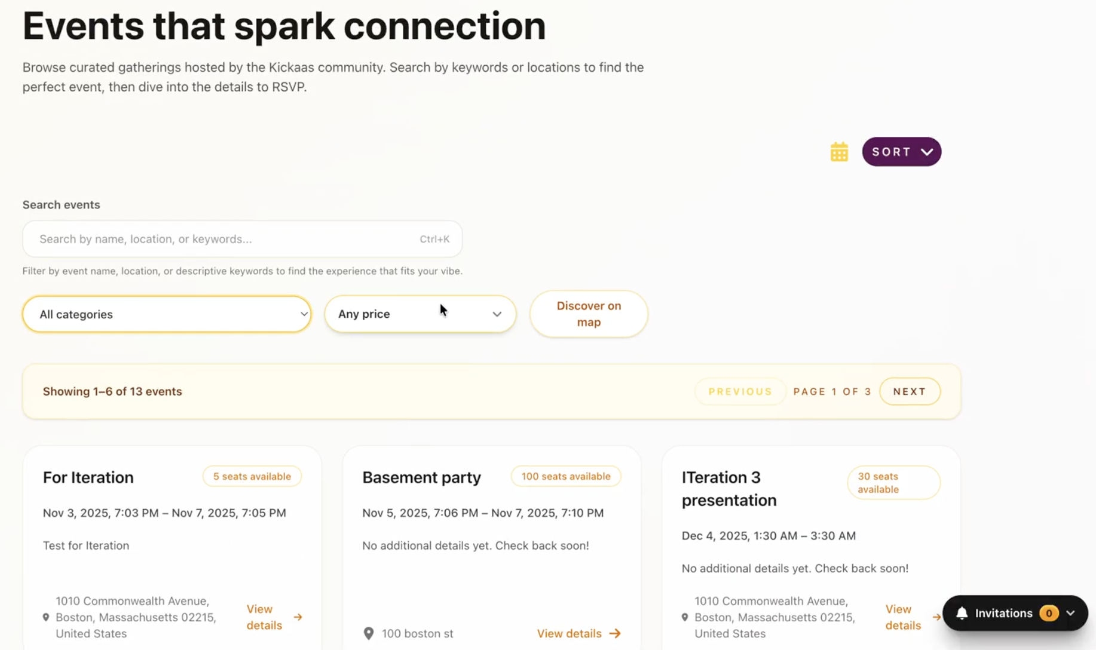
Notes:
Saniya

Slide 30
EVENTS CARD
Each event created has its own event card which displays all of the details from the Create Event form. In addition, it shows details according to if the user is the Host or a Guest.
Host
Invitation
Name
Email
User ID
Guest
Registration (RSVP)
Going
Maybe
Not Going
Notes:
Saniya

Slide 31
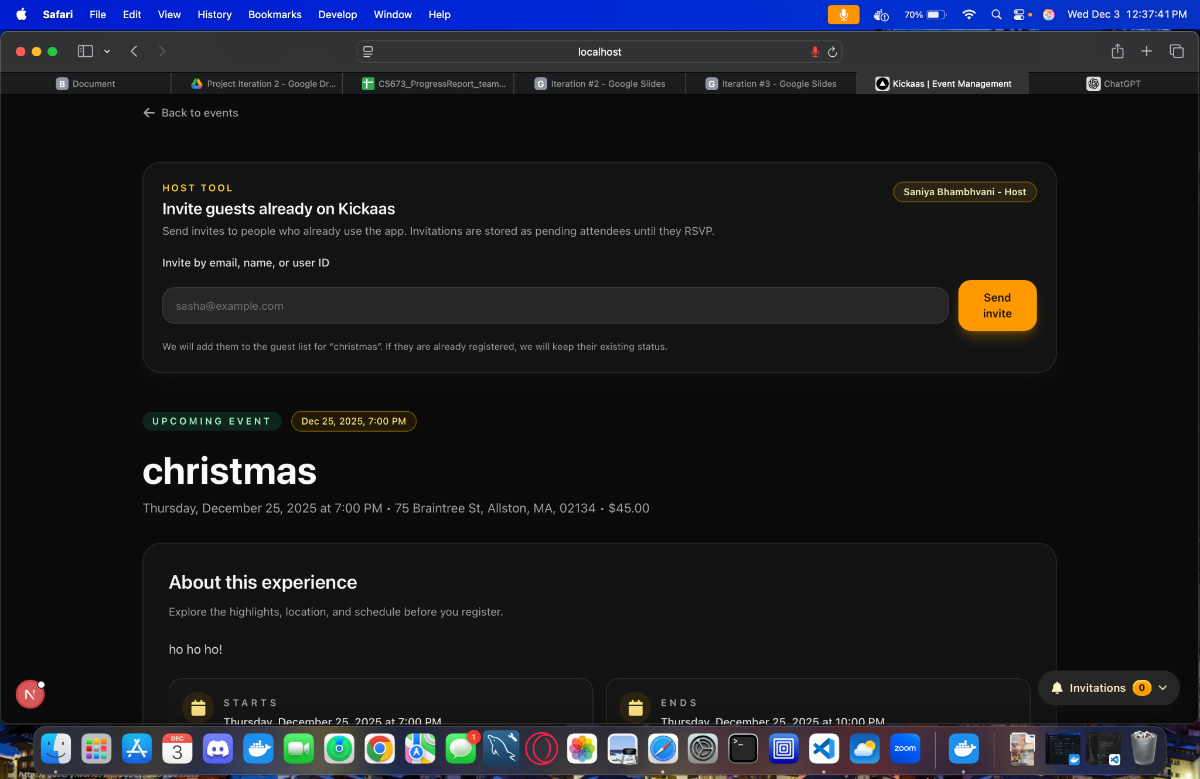
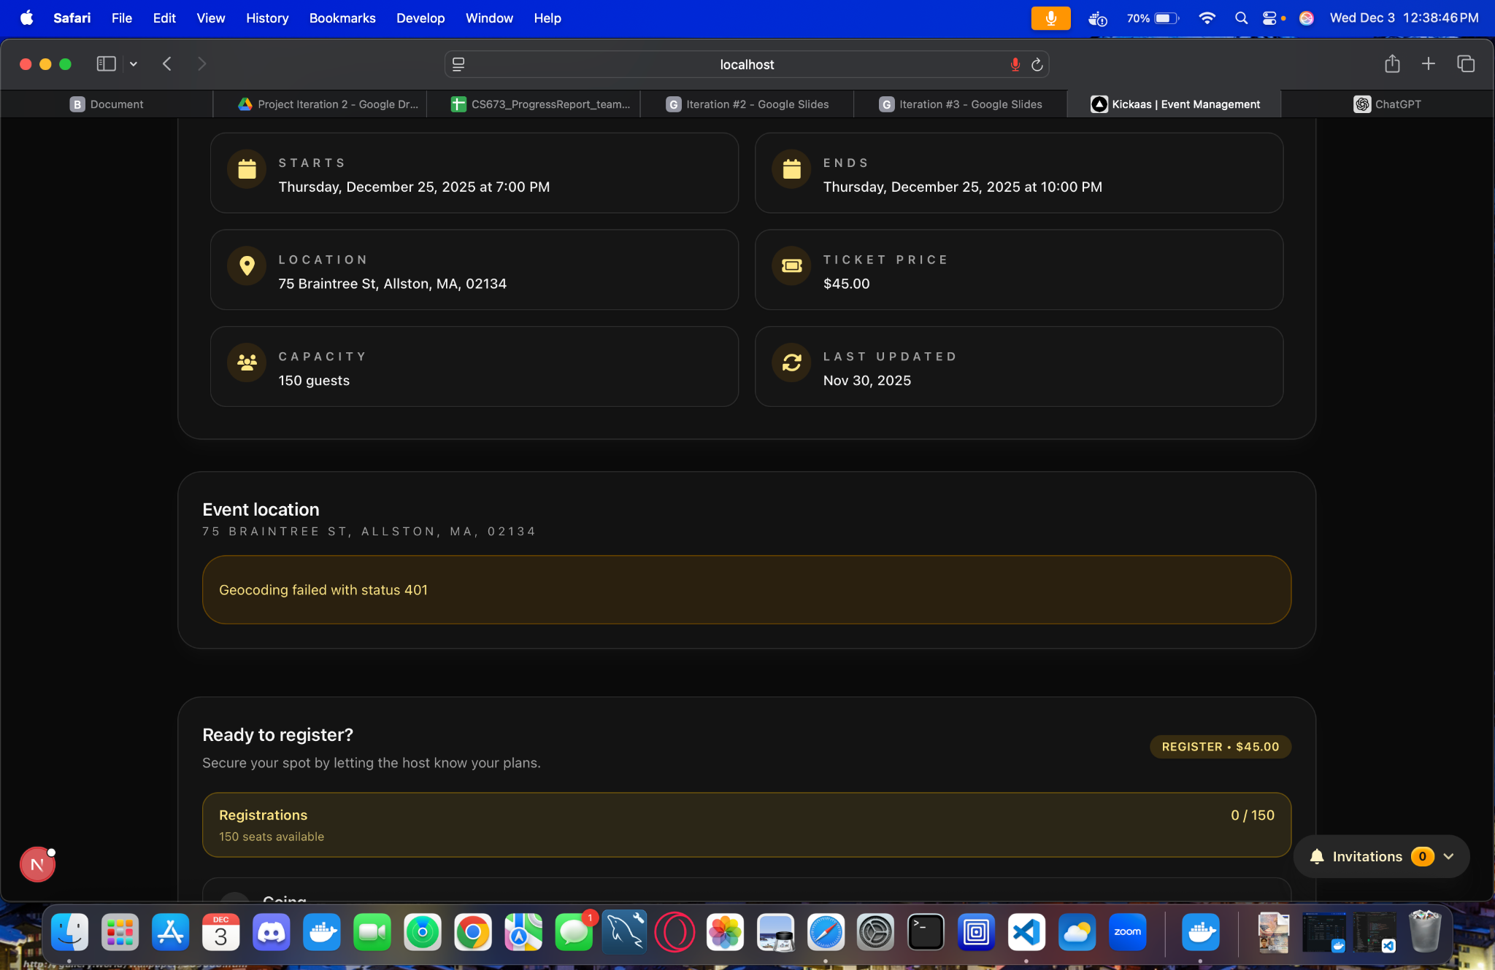
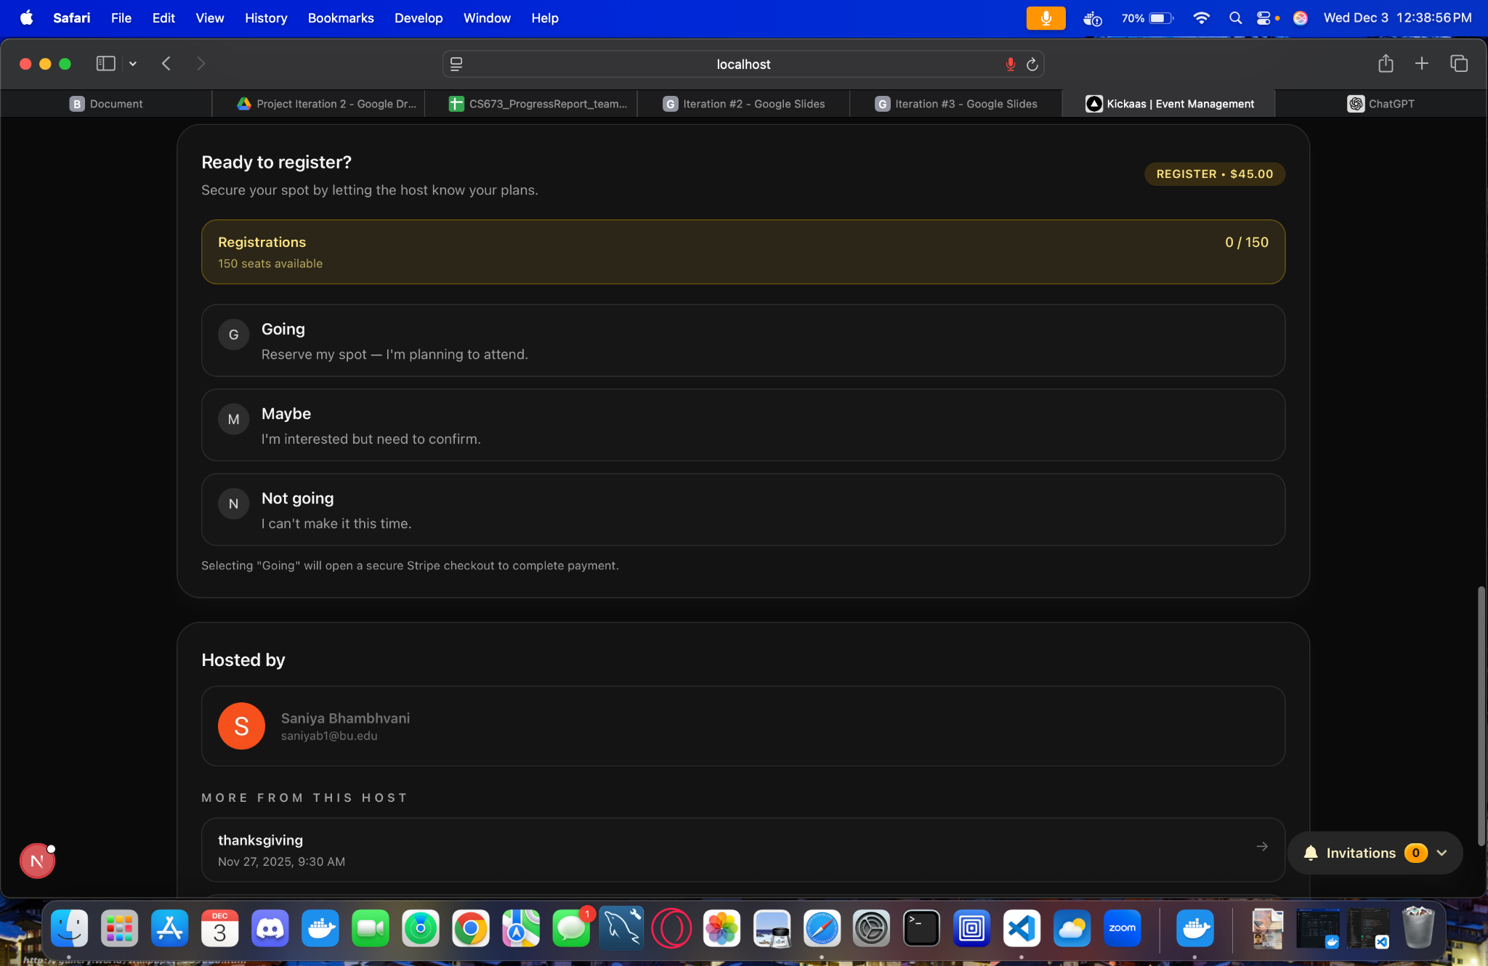
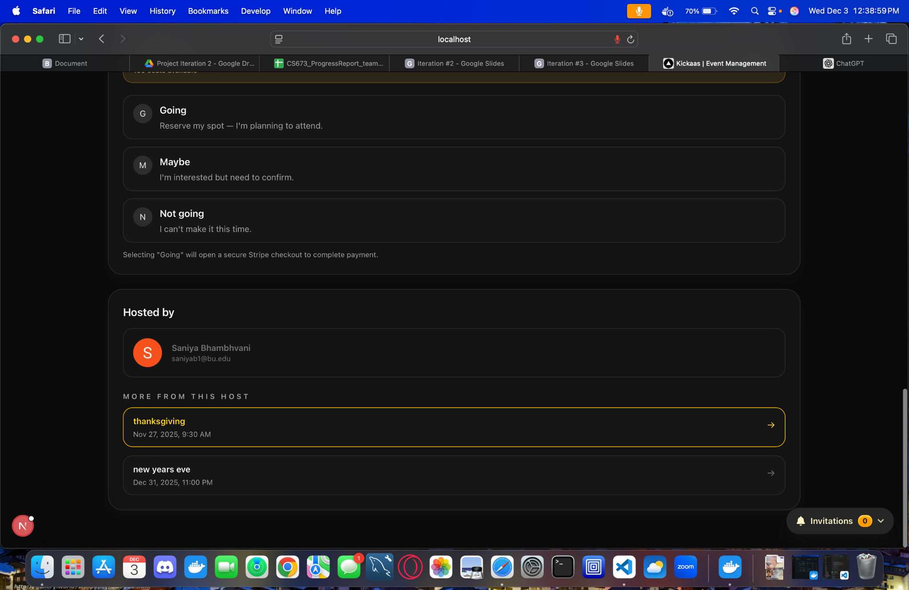
Notes:
Saniya

Slide 32
MAP DISCOVERY
The Map feature on the Events page takes the events created and pins them on a map. This enhances the overall experience by being more:
Interactive
Visual
User-Friendly
Notes:
Sai

Slide 33
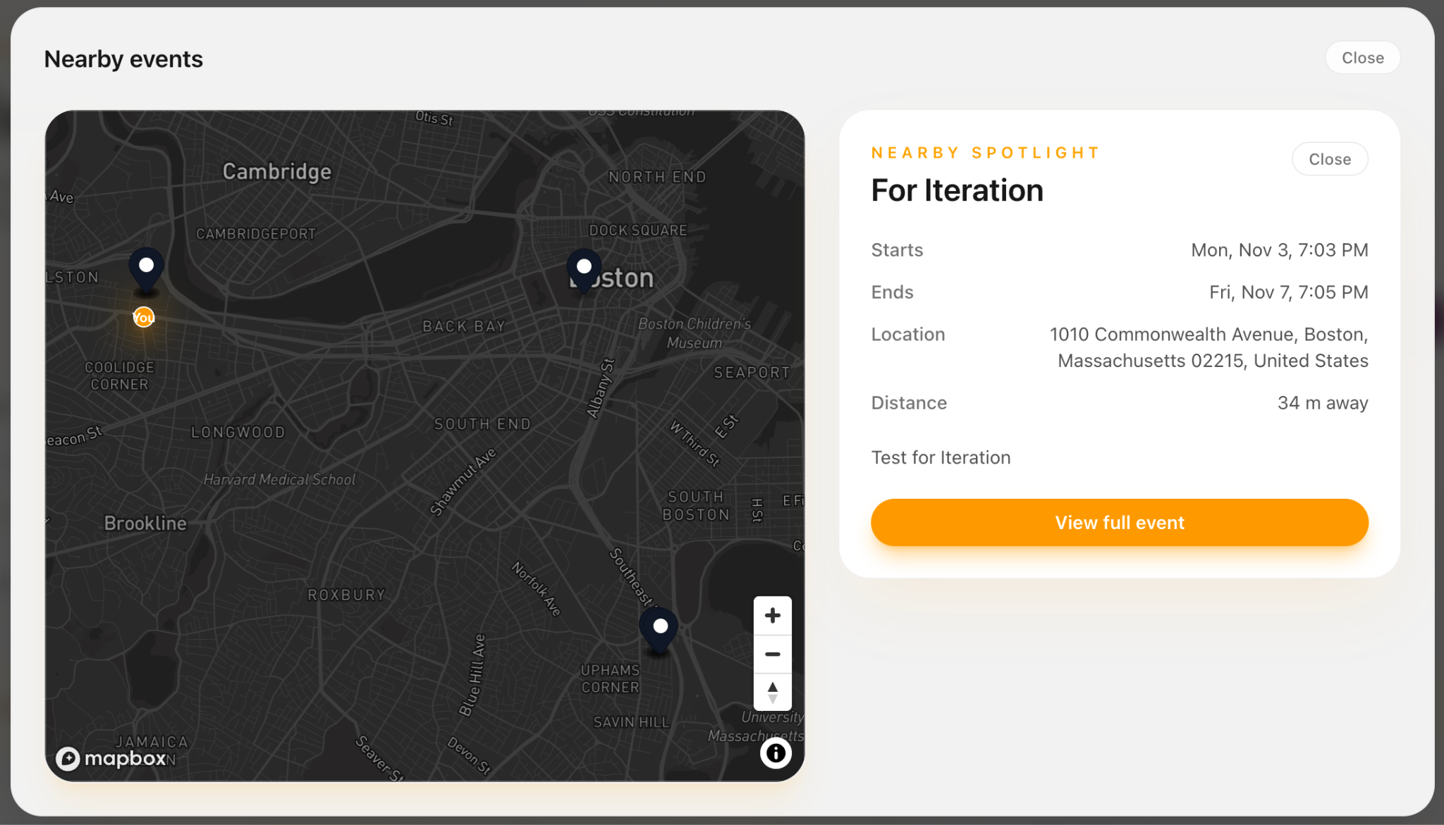
Notes:
Sai

Slide 34
INVITATIONS
As mentioned previously, if the user is the Host of an event, they can send invitations to other users using either their:
Name
Email
User ID
Once the guest users complete their RSVP, the data is stored and updates the seat count accordingly
Notes:
Sai

Slide 35
PAYMENT SUPPORT
If an event has a price listed and the user is attending the event, the user is able to pay through Stripe.
Stripe Integration Support
Notifies the backend via a webhook
Backend does not store raw card information
Notes:
Sai

Slide 36
USER PROFILE
The User Profile will allow the user to view their account information. In addition, it displays when they joined Event Manager, how many events they have created, and an organized list of all of their events divided into three categories:
Created
Registered
Upcoming
Notes:
Sai

Slide 37
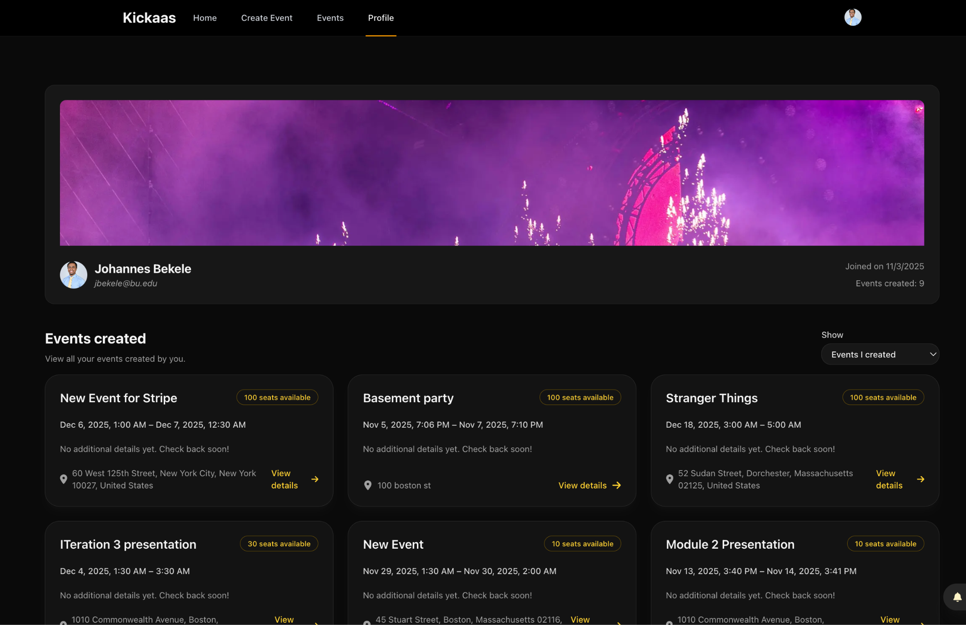
Notes:
Sai

Slide 38
SIGN UP/SIGN IN
The Sign Up/Sign In feature allows the user to make an account or log in to their existing account through Google via Clerk.
The user uses their Google account
Clerk sends a signed webhook to the Next.js app
Next.js verifies and creates the new user
Information is stored in the Users database
User can successfully log in
Notes:
Sai

Slide 39
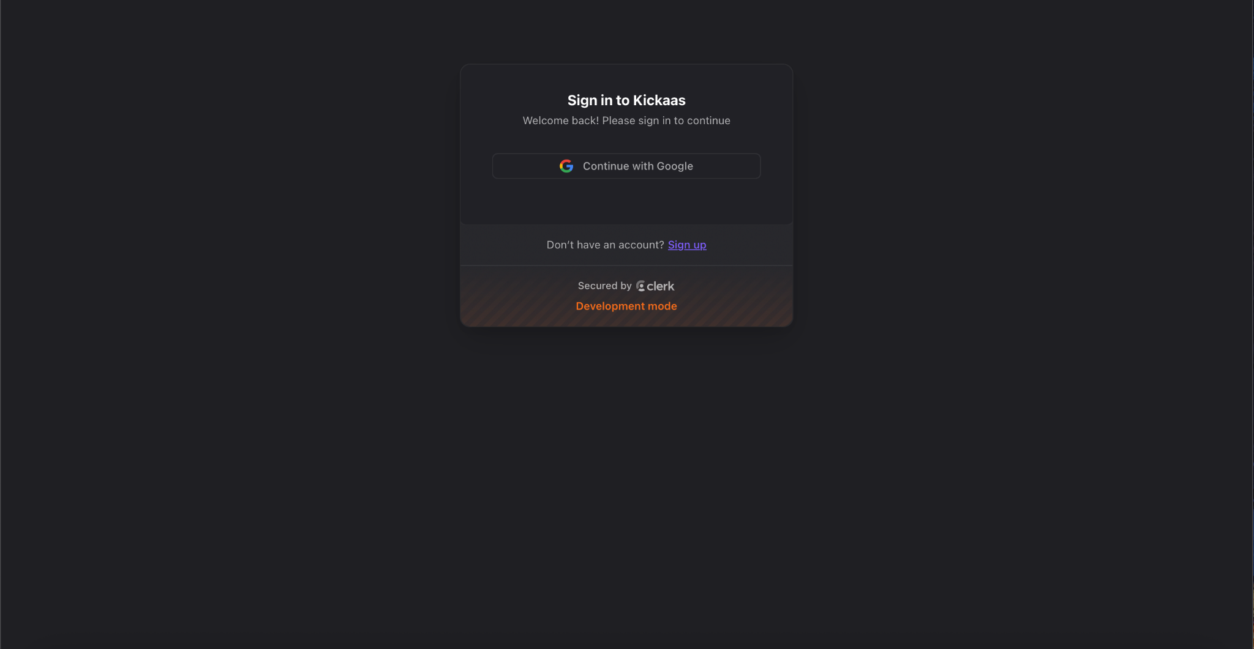
Notes:
Sai

Slide 40
DEMO
DEMO
DEMO
DEMO
DEMO
Notes:
Johannes

Slide 41
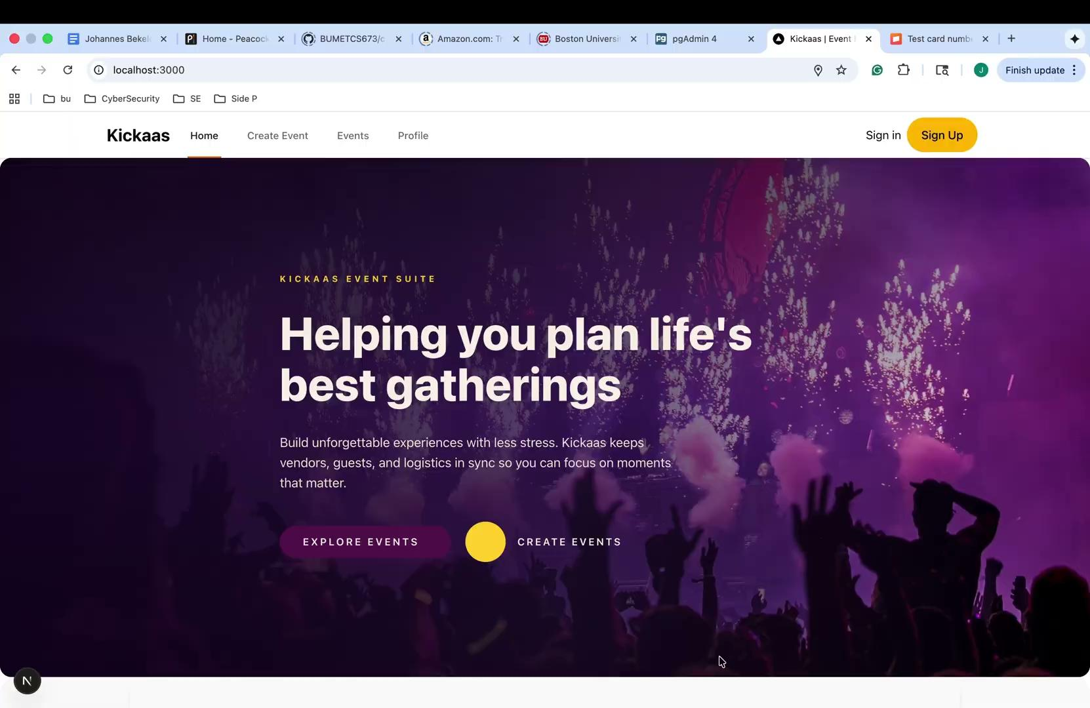
Notes:
Johannes

Slide 42
TESTING
TESTING
TESTING
TESTING
TESTING
Notes:
Javi and Keni

Slide 43


AUTOMATED TESTING:
ITERATION #1 and #2
Backend
Total Tests Executed: 122
Test Result: 100% Pass Rate
Test Execution time: 3.03s
Overall Coverage: 71%
Frontend
Total Tests Executed: 13
Test Result: 100% Pass Rate
Test Run Time: ~3.37s
Overall Coverage (Statements): 83.98%
Branch Coverage: 62.5%
Function Coverage: 68.75%
Line Coverage: 83.98%
Notes:
Automated testing:
Ran using github action during the ci pipeline
When:
Everytime a new pr is created against main
Everytime there is a new push to any remote branch
Where:w
test folders under the code/backend and code/frontend dirs
Why:
Ensure new functionality does not break existing functionality

Slide 44
AUTOMATED TESTING:
ITERATION #3
Backend
Total Tests Executed: 200
Test Result: 100% Pass Rate
Test Execution time: 4.02s
Overall Coverage: 80%
Frontend
Total Tests Executed: 67
Test Result: 100% Pass Rate
Test Run Time: 5.9s
Overall Coverage (Statements): 85.15%
Branch Coverage: 69.92%
Function Coverage:78.72%
Line Coverage: 85.15%
Notes:
Javi / Keni
Automated testing:
Ran using github action during the ci pipeline
When:
Everytime a new pr is created against main
Everytime there is a new push to any remote branch
Where:w
test folders under the code/backend and code/frontend dirs
Why:
Ensure new functionality does not break existing functionality

Slide 45
MANUAL TESTING
Manual Testing involved conducting end-to-end tests for both the frontend (Next.js) and backend (FastAPI) to verify functionality for:
User Registration
Login
Event Creation
Event Listing
RSVP Payment
Invitations
Verified frontend and backend integration — Database updates confirmed via PostgreSQL.
Total Tests Executed: 13
Iteration #1: 3 Tests
Iteration #2: 4 Tests
Iteration #3: 6 Tests
Test Result: 100% Pass Rate
Notes:
Keni
Manual testing:
Ran by QA leader
When:
Week iteration is done
Where:
localhosted full stack application
Why:
Ensure end to end functionality

Slide 46
MANUAL TESTING
Registration and Login
Correct credentials, wrong passwords, invalid email , duplicate registration attempts, and session persistence
Event Creation
Required fields, past date prevention, invalid location handling, and whether the created event actually appears in the event list
Filtering
Category filters, keyword searches, and responses to invalid filters, ensuring the UI updates instantly without errors
Profile Page
Created events, attending events, and also tested accounts with zero events to ensure the UI does not break
Navigation
Checked that buttons, redirects, and page transitions behave consistently and match user expectations
Notes:
Keni
Manual testing:
Ran by QA leader
When:
Week iteration is done
Where:
localhosted full stack application
Why:
Ensure end to end functionality

Slide 47
QUESTIONS?
QUESTIONS?
QUESTIONS?
QUESTIONS?
QUESTIONS?

